Slide 1

Data Analytics Job Opportunities
November 11, 2021

Slide 2
Objective
Address a need or answer a question for individuals
Demonstrate skills to date including machine learning
Design a website to answer a user question
Question we wanted to answer: Could we predict a salary for a website user when they selected specific criteria they wanted for a job opportunity?

Slide 3

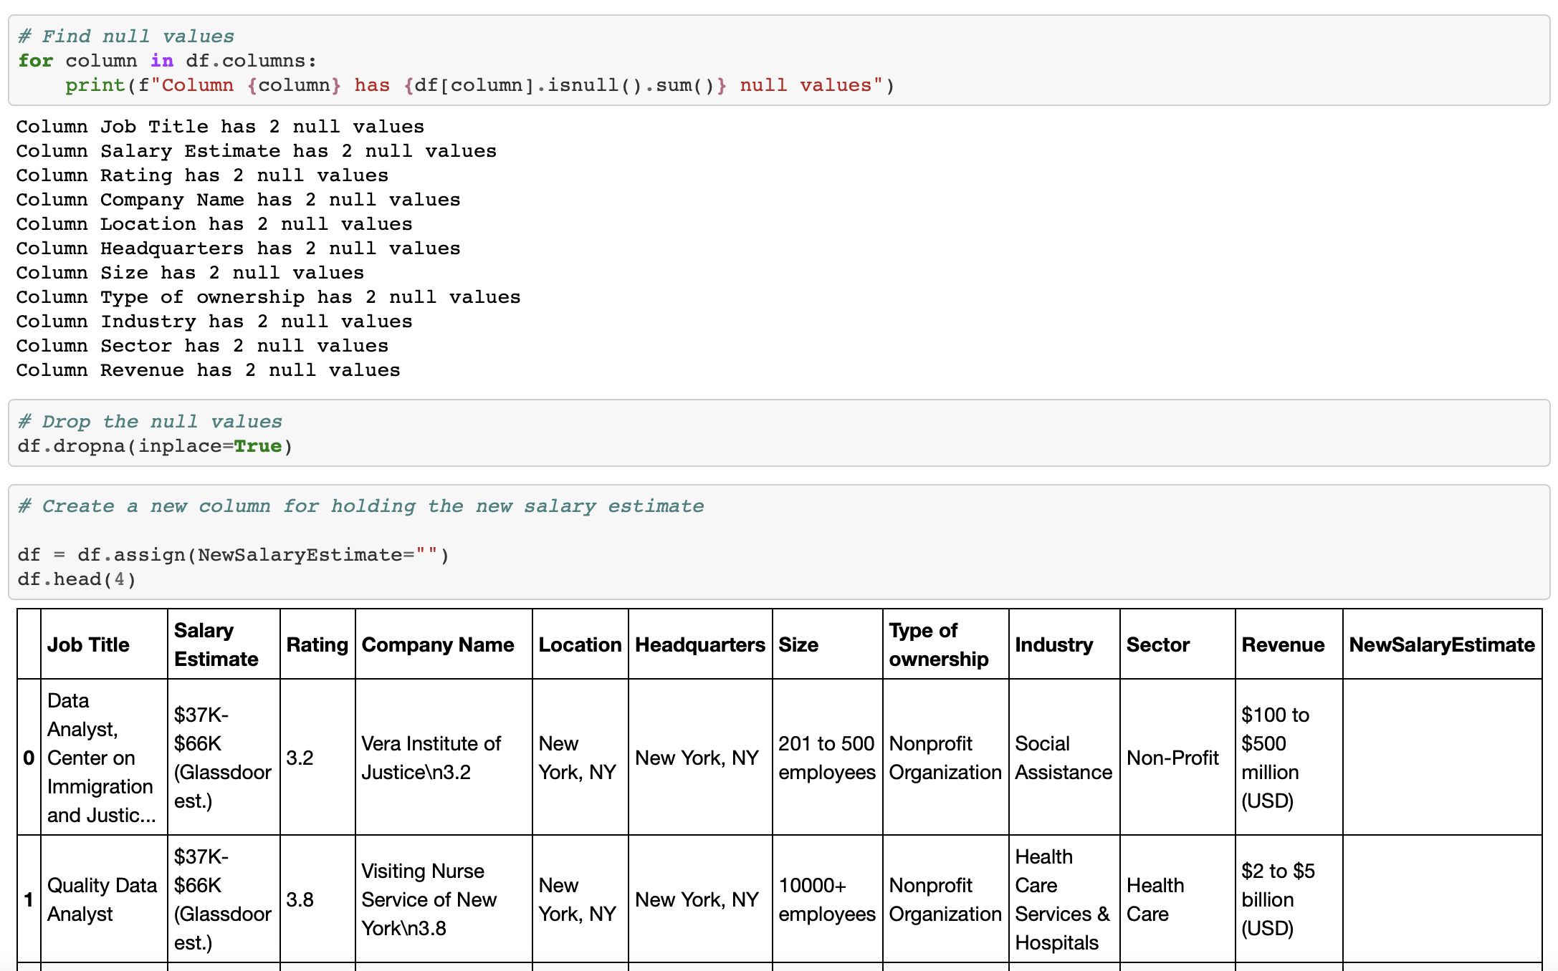
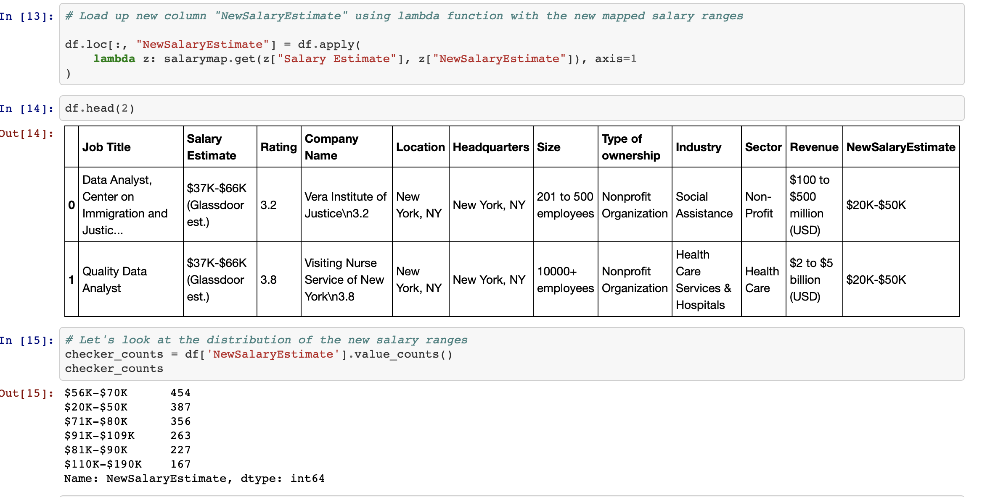
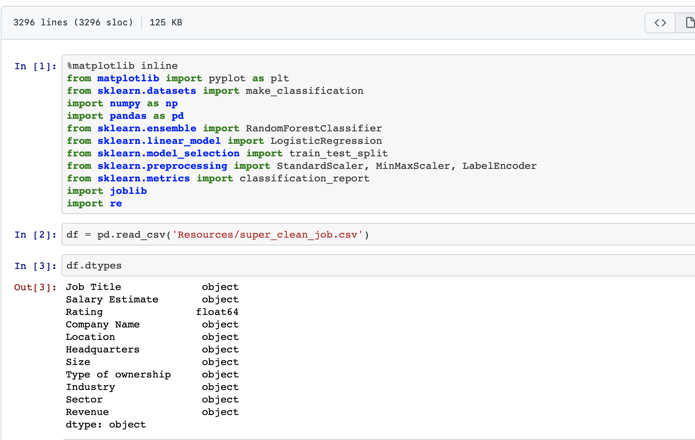
Data Cleaning
Selected dataset from Kaggle.com
Removed unnecessary columns
Removed incomplete/null values
Still contained over 1800 data points
Used Excel & Jupyter Notebook

Slide 4

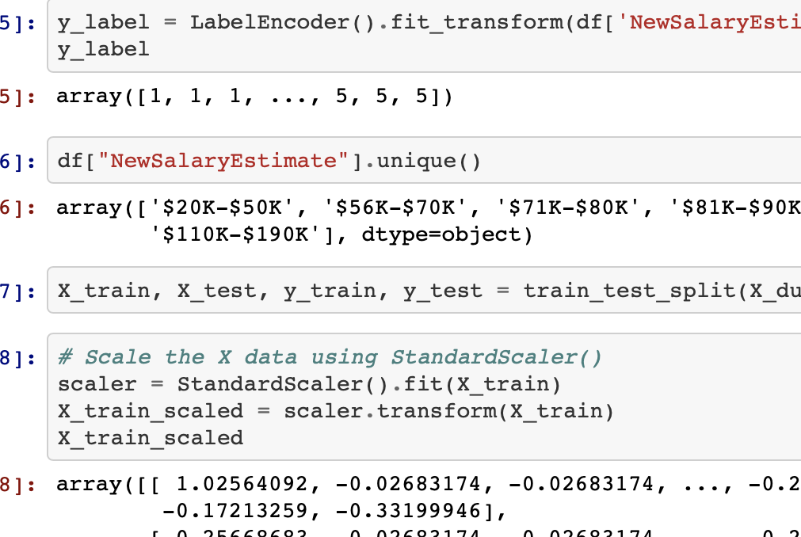
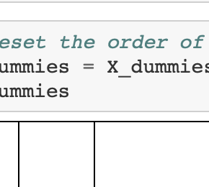
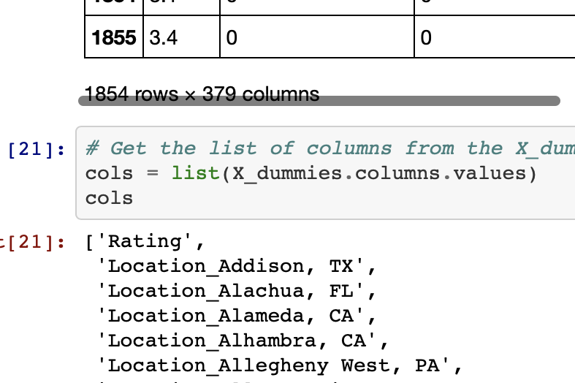
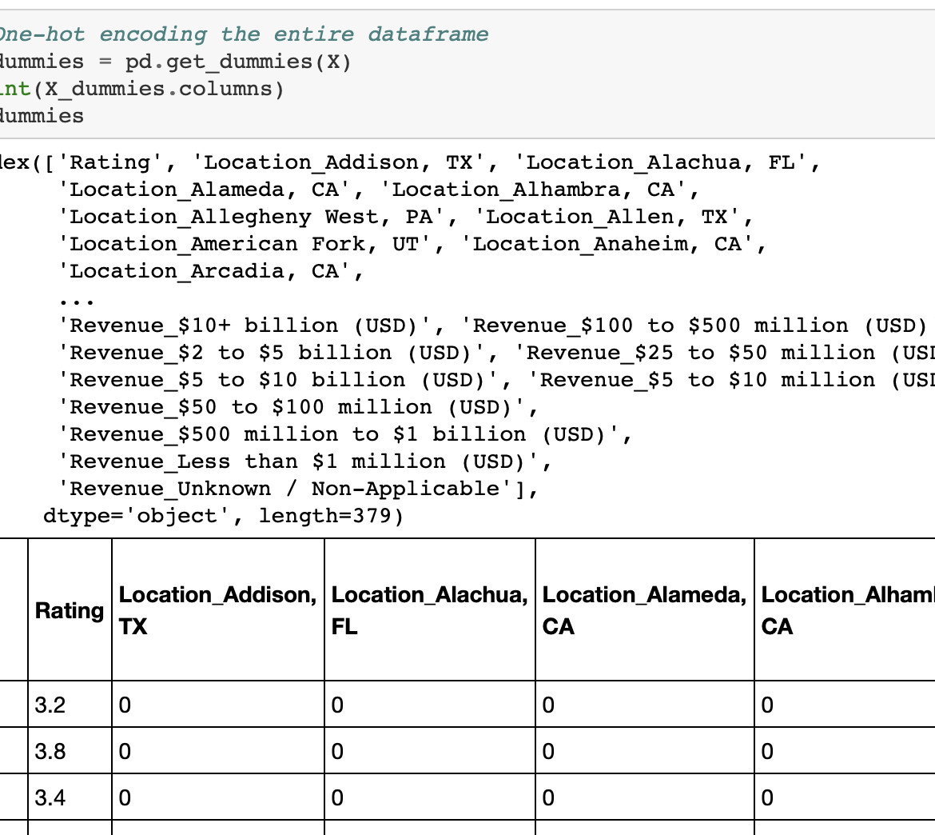
Machine Learning
Reviewed multiple ML strategies Random Forest and Random ForestRegressor
Aligned on using Random Forest Classifier
Label, Scale, Fit, Predict
Adequate accuracy for the proposal
Used Jupyter Notebook, Python

Slide 5
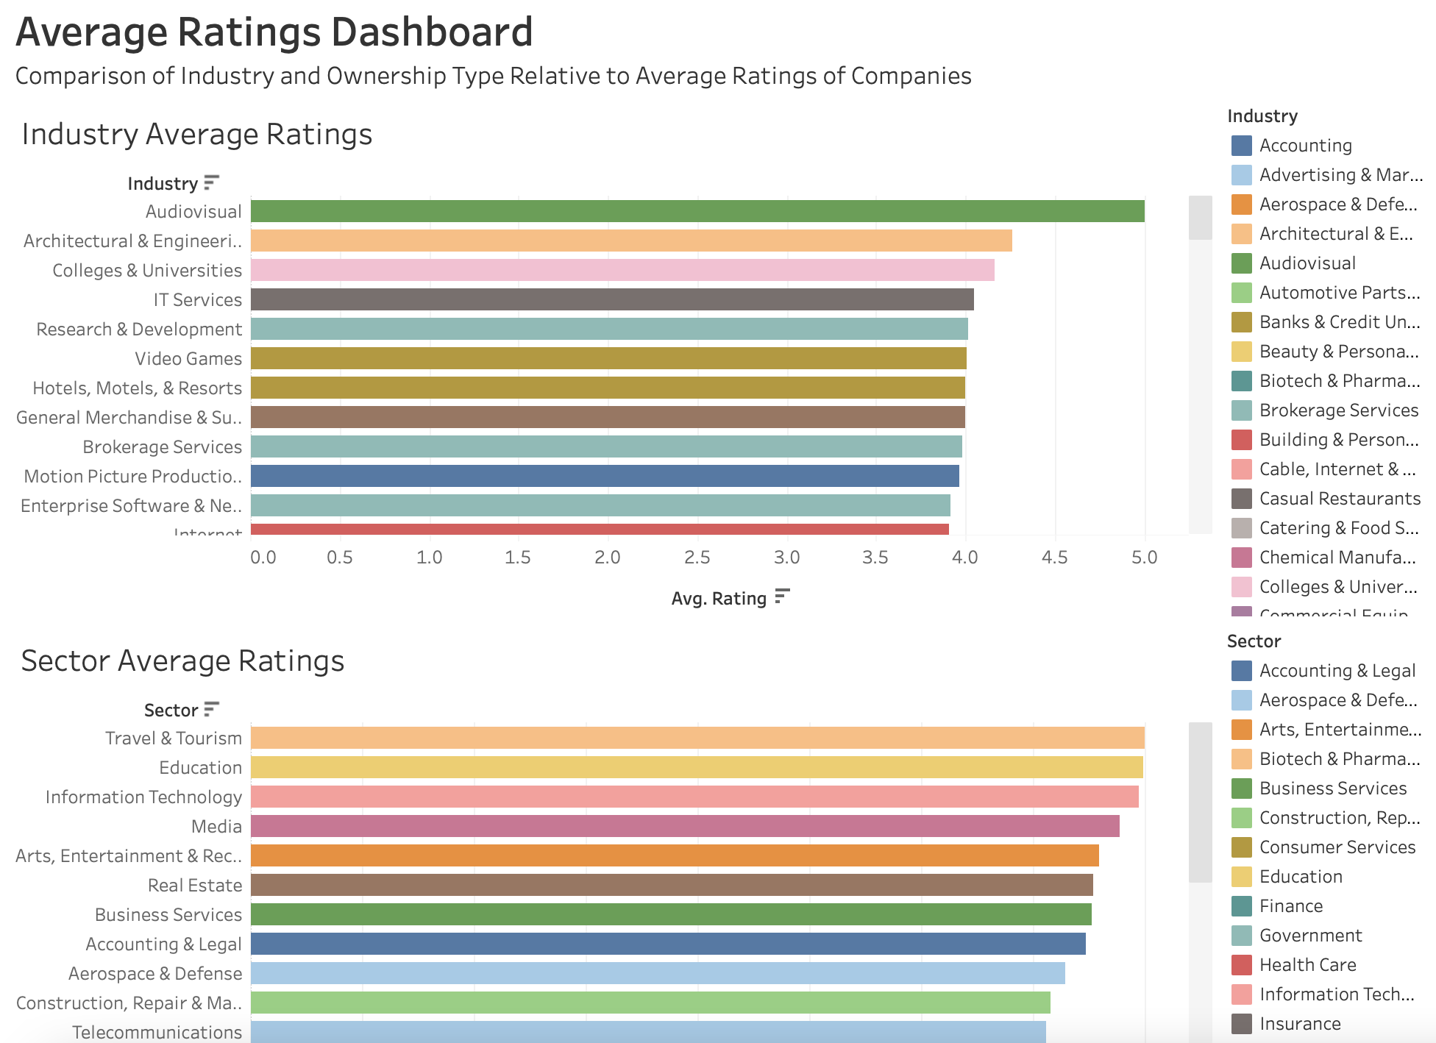
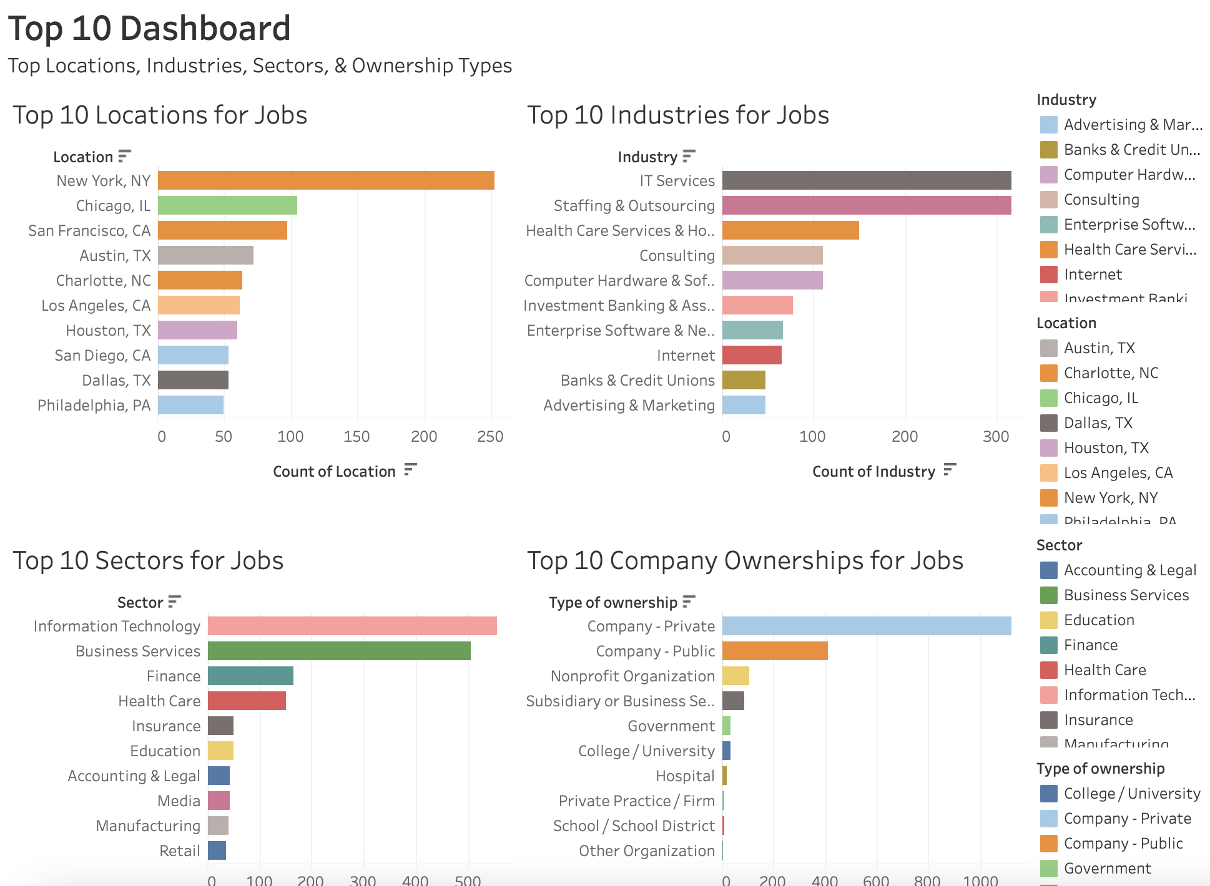
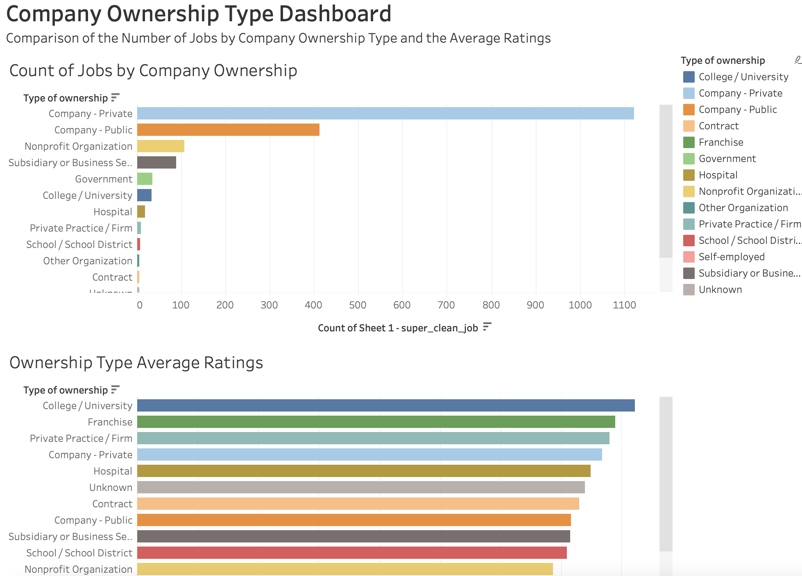
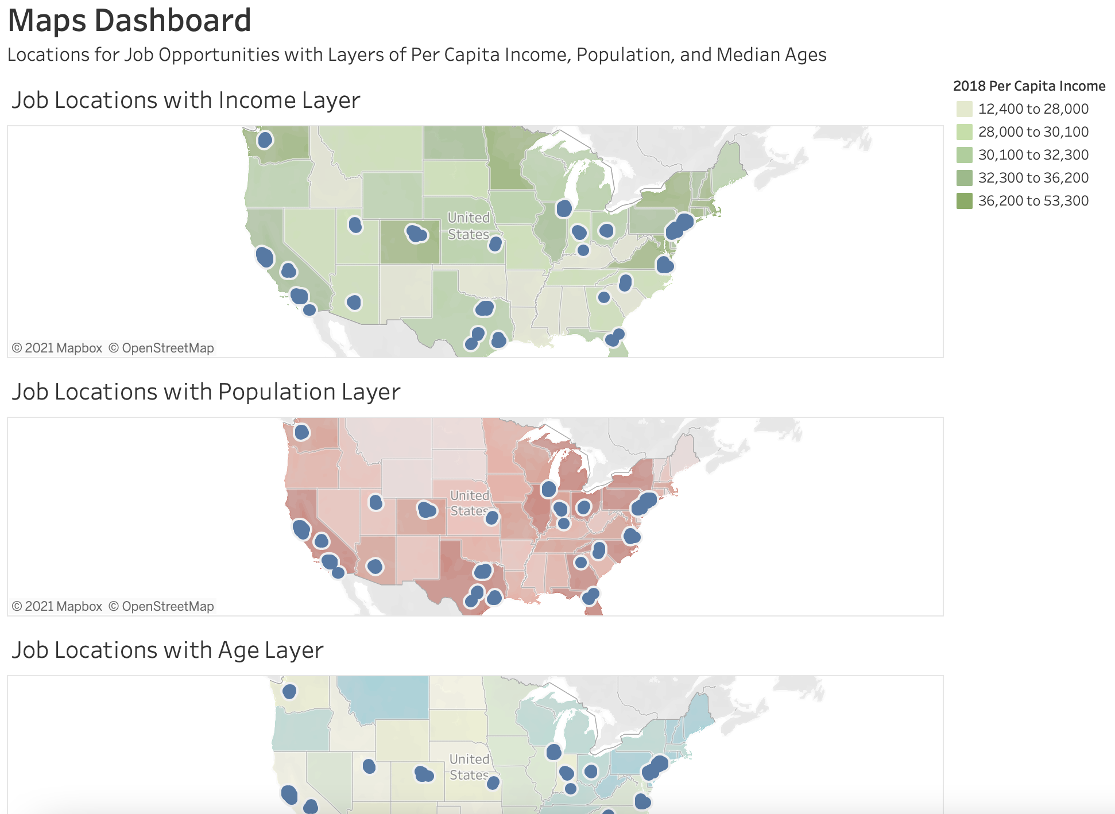
Data Visualizations
Top 10 Locations, Industries, Sectors, and Company Ownership Types
Average Ratings by Locations, Industries, Sectors, and Company Ownership Types
Maps of Locations with Income, Population, and Median Age Layers
Used Tableau

Slide 6
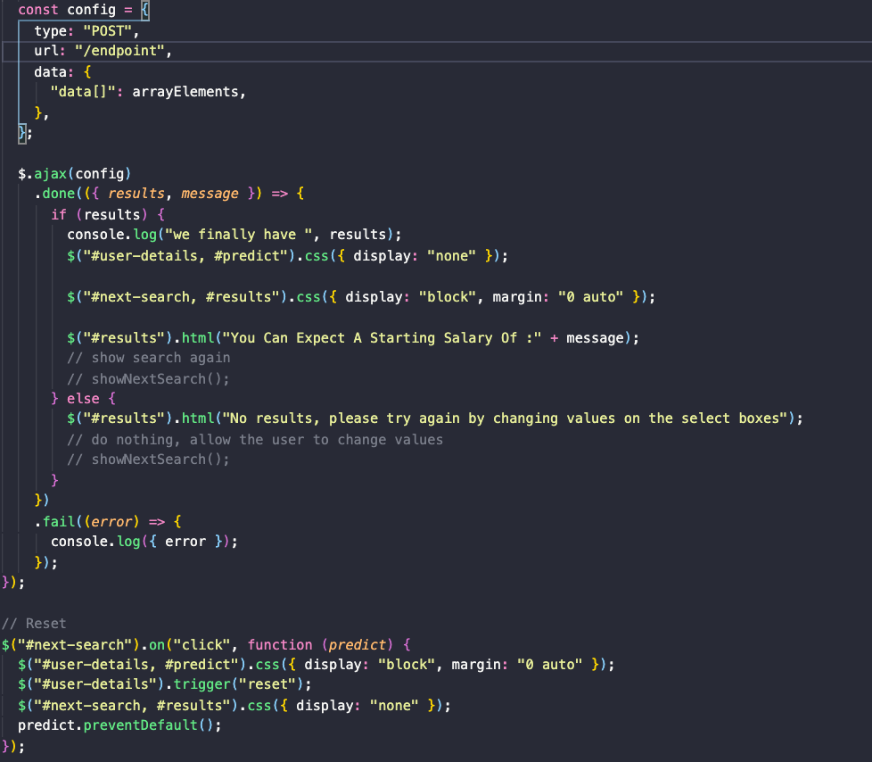
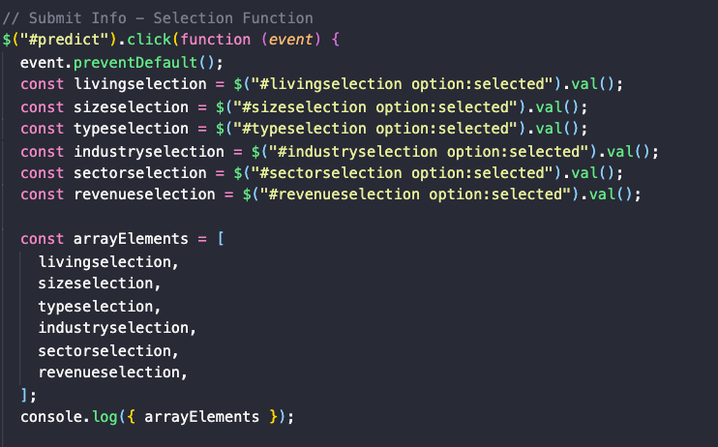
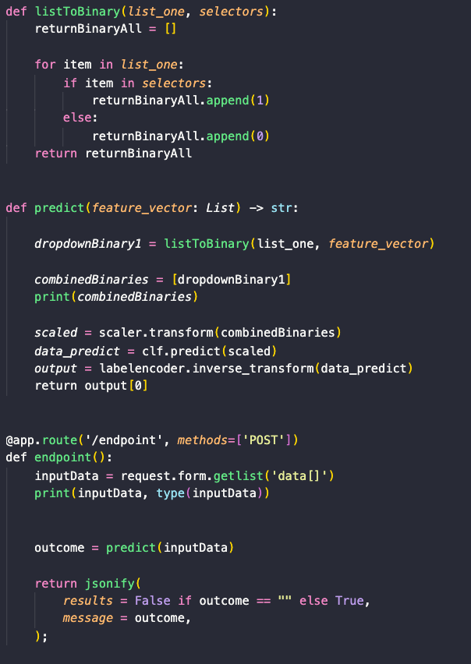

Coding
Created variables for each selection using JQuery
Converted those selections into an array
Created an ajax function for the user to toggle back and forth between their selection and results
Defined the entire drop down list and converted to binary labels; converted to an array; connected the array to a predict function
Used HTML, Flask, and JavaScript

Slide 7

Website
Let’s take a look!

Slide 8







Software or Languages Used

Slide 9

THANK YOU!
Team Members:
Byron Pineda
Carlyse Thomas
Felicia Felix
Heather Mott
Peta Gaye Lysius
Ryan Flammia

